Slide 1
LibEr E-Commerce Book Store
Scott Pelletier & Dongguo Wu

Slide 2
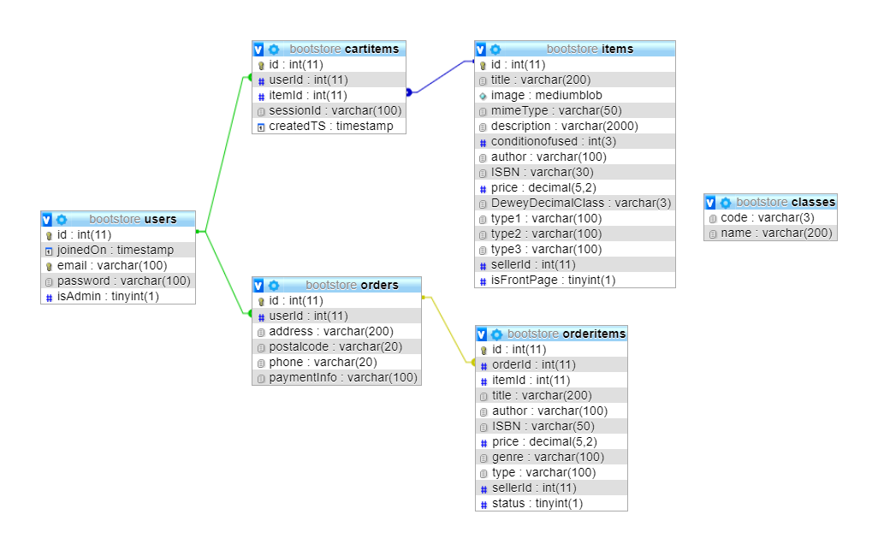
Database Structure:

Slide 3
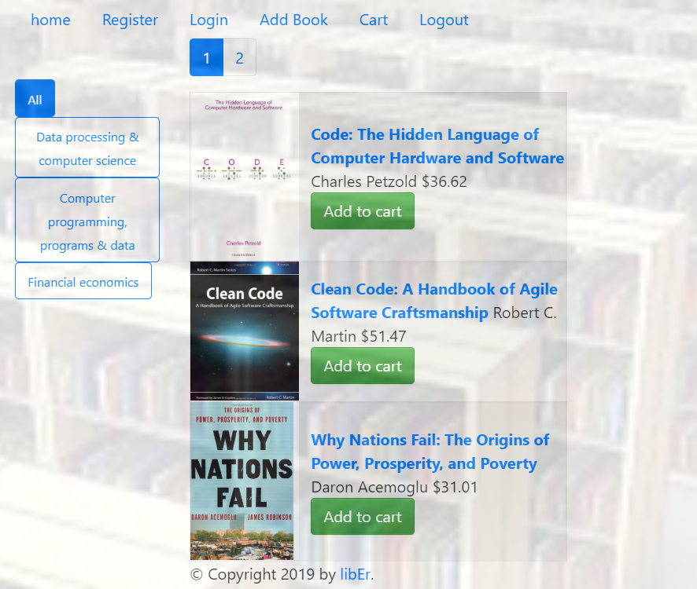
Database Structure: Cart

Slide 4
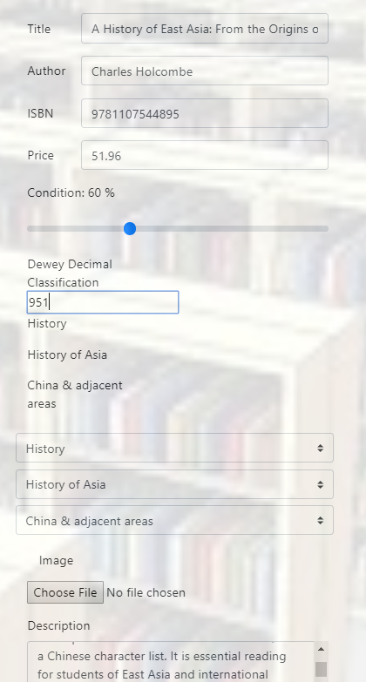
User Cart Cart.html

Slide 5
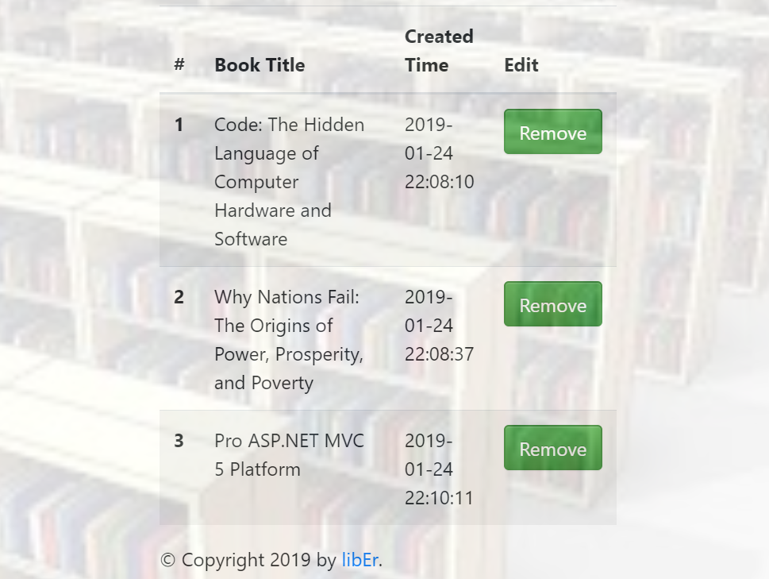
Main Page: index.html

Slide 6
Database Structure: Items

Slide 7
Bootstrap: Columniation

Slide 8
Font Awesome

Slide 9
Pagination

Slide 10
DeweyDecimalClass

Slide 11
Still to Come

